Slide 1



EVENT MANAGEMENT
DATABASE SYSTEM
DAMG6210 - Database Management and Database Design
Presented by:
Sharan Kumar Prabhakaran
Yashaswani Naga Parnika
Harshika Golkonda
Santosh Rayana
GROUP NUMBER: 15

Slide 2


ROLE OF DATABASE
IN
EVENT MANAGEMENT SYSTEM
ABOUT
PURPOSE
A comprehensive database management application designed to streamline event organization, coordination, and management.
Aims to serve event planners, organizers, and attendees by offering a centralized platform for event-related tasks.
To provide a user-friendly system for managing all aspects of event planning and coordination.
It enhances the attendee experience by providing seamless registration processes and interactive features such as feedback forms.
To Efficiently manage the participant data, registration, and attendance.
To Reduce the manual effort and saves time in organizing events.
To facilitate data-driven decision-making and strategic planning through comprehensive reporting and analysis.
Technologies Used:
Frontend: Python with the Tkinter library for a graphical user interface.
Backend: Microsoft SQL Server for database management.

Slide 3
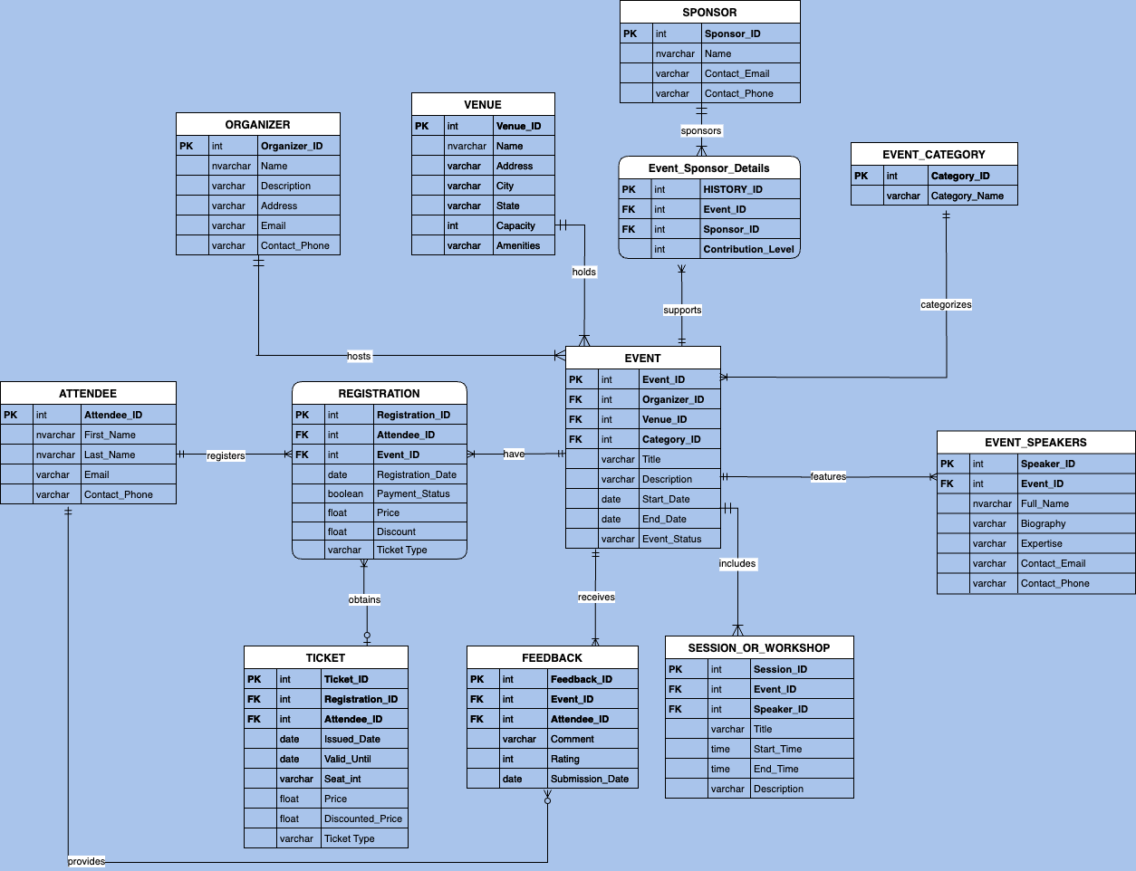


ERD

Slide 4

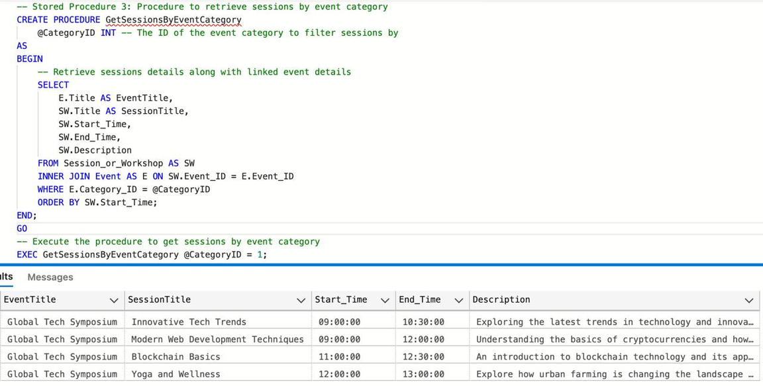
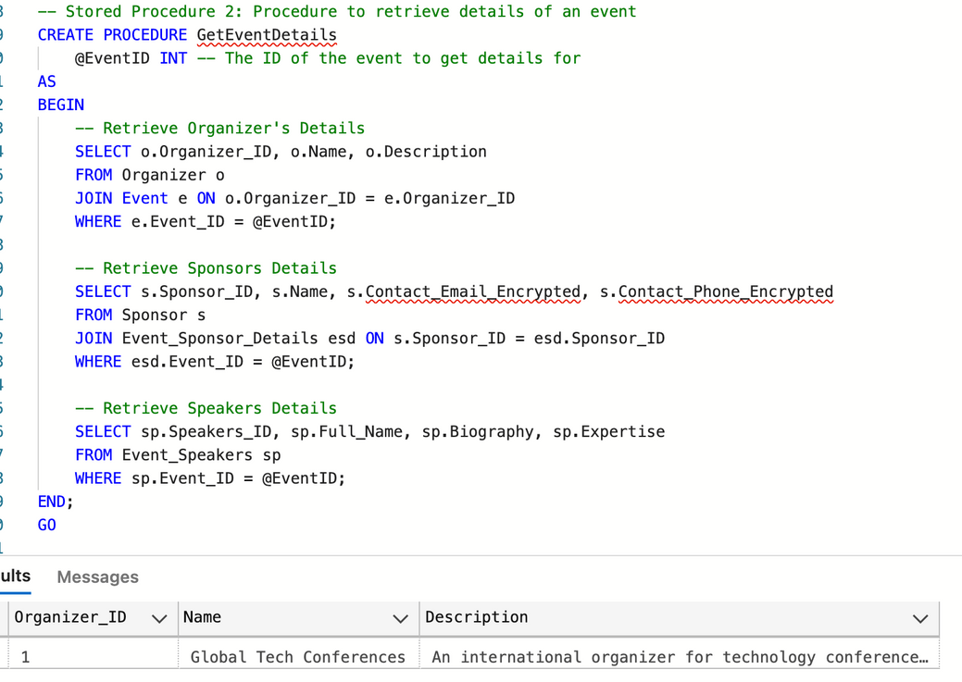
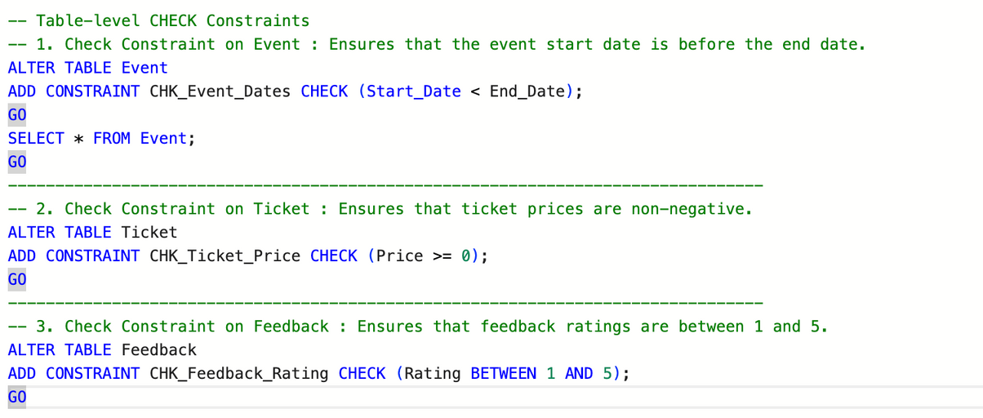
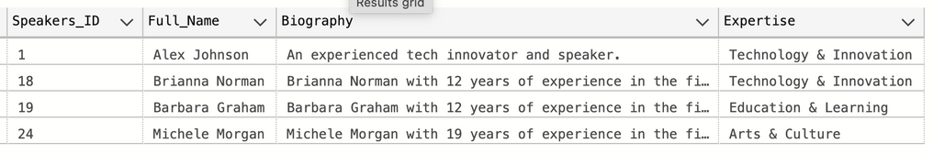
PROCEDURE TO RETRIEVE EVENT DETAILS
PROCEDURE TO GET SESSIONS BY EVENT CATEGORY
TABLE LEVEL CHECK CONSTRAINTS

Slide 5


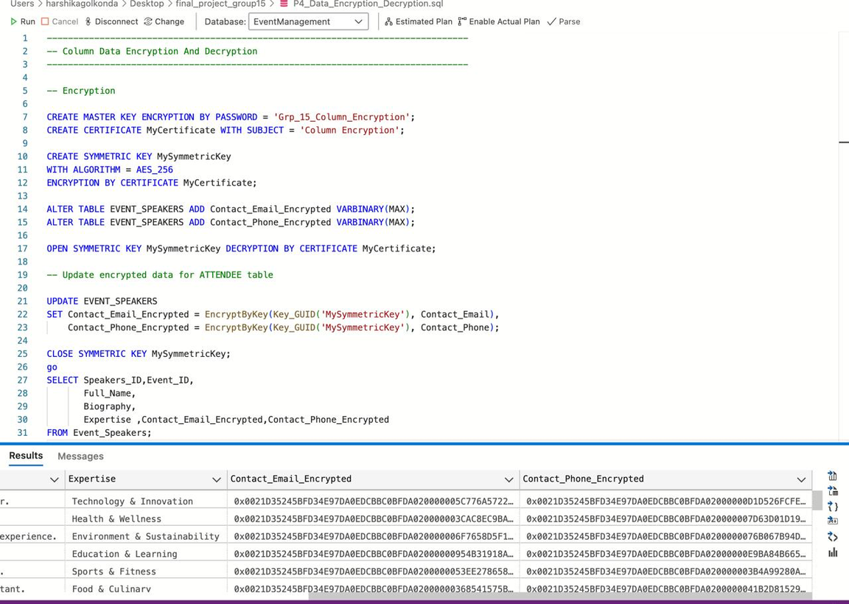
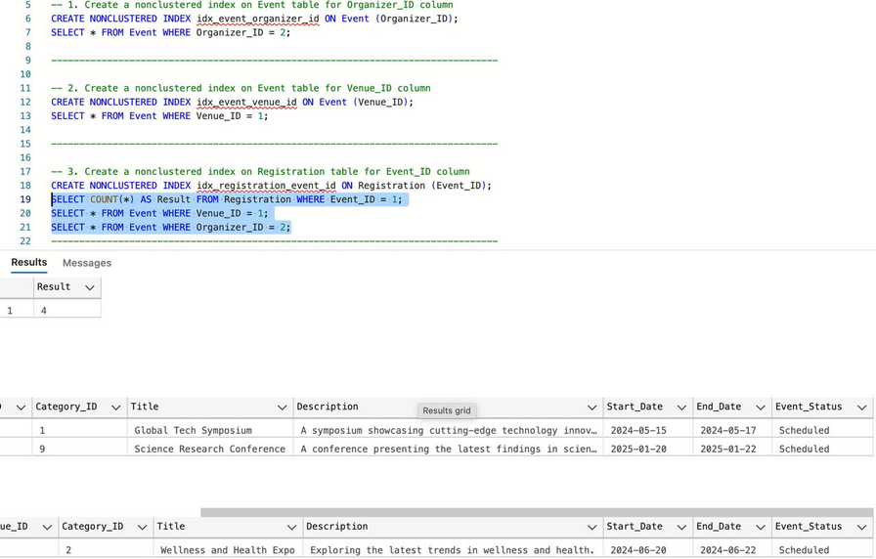
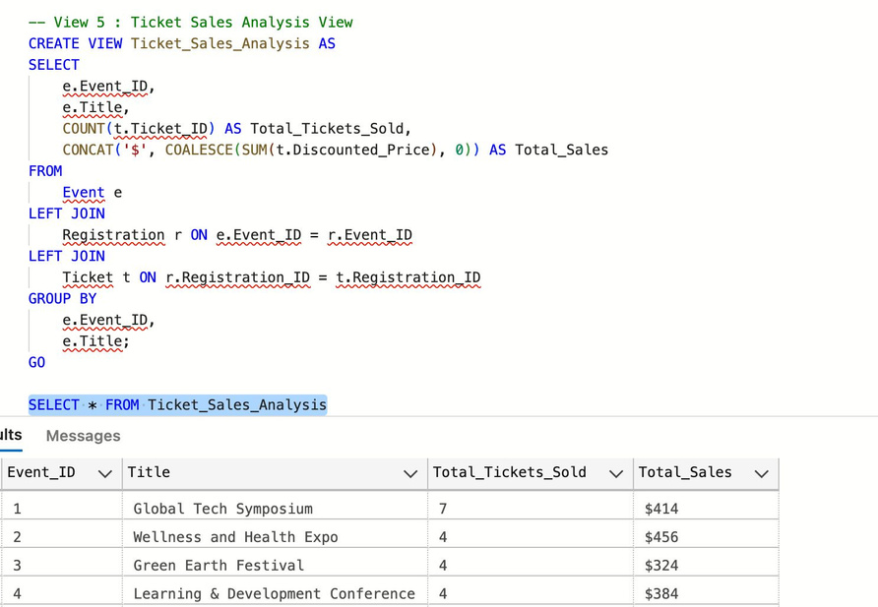
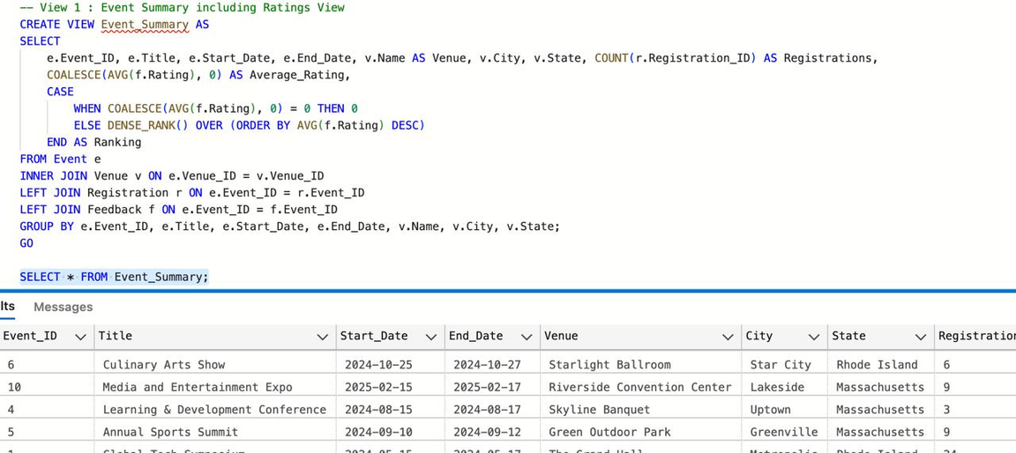
ENCRYPTION
NON CLUSTERED INDEX
TICKET SALES ANALYSIS VIEW
EVENT SUMMARY VIEW

Slide 6
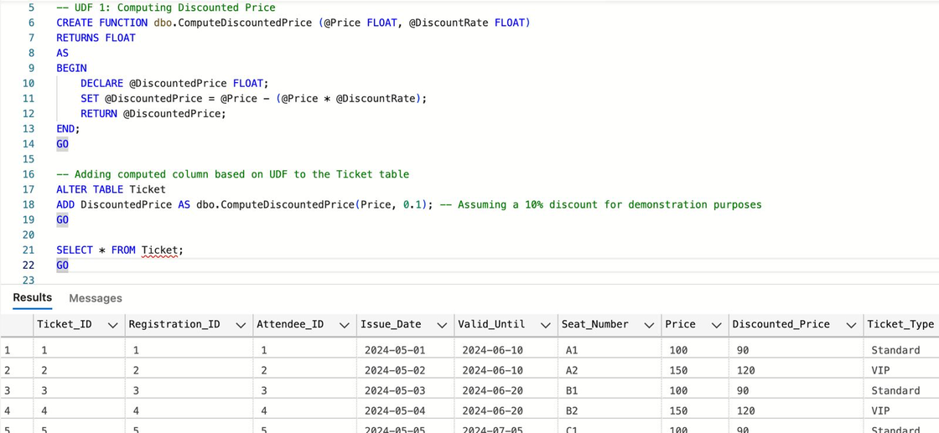
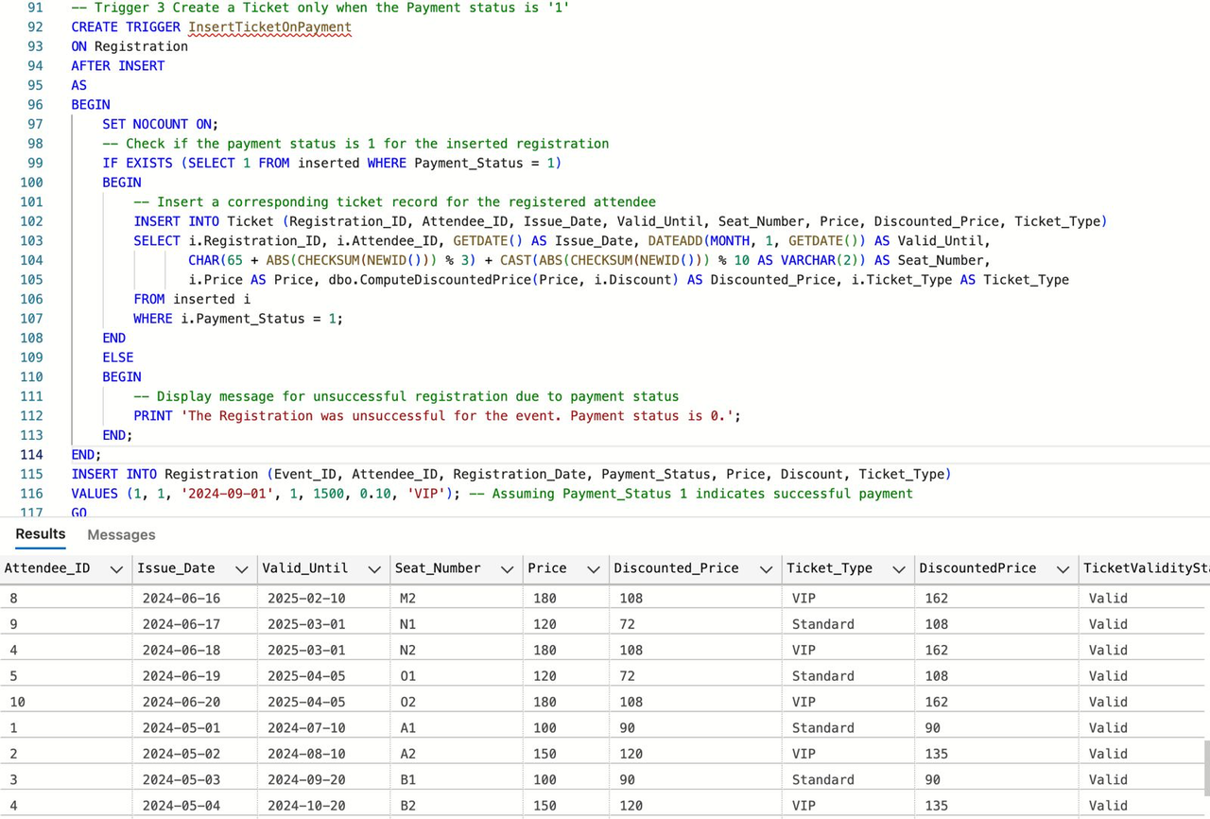
TICKET GENERATION TRIGGER
DISCOUNTED PRICE UDF

Slide 7

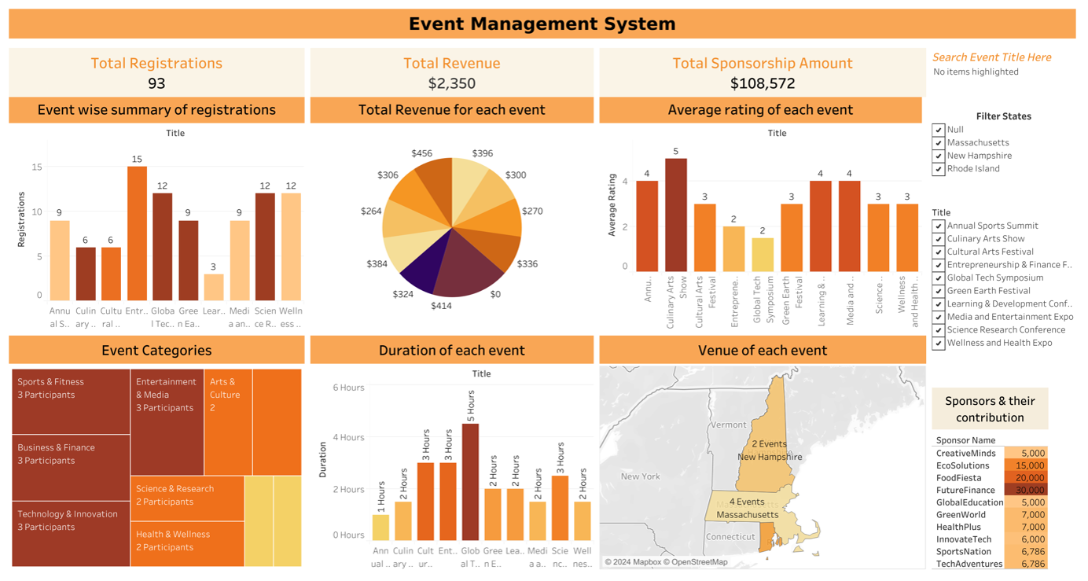
DASHBOARD

Slide 8

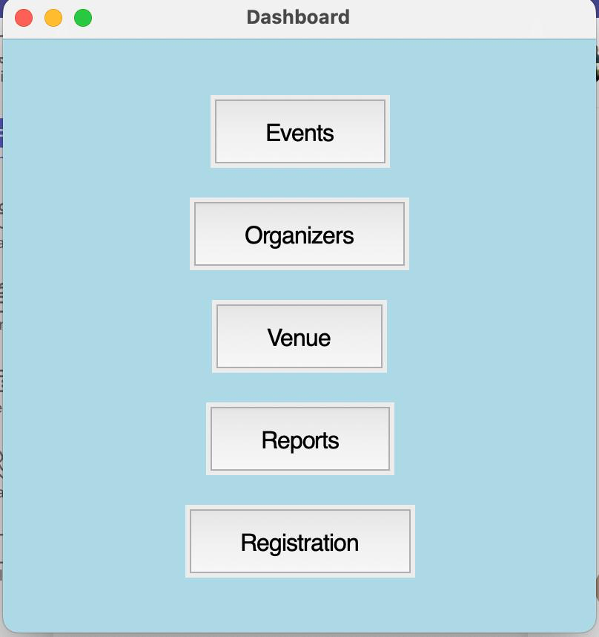
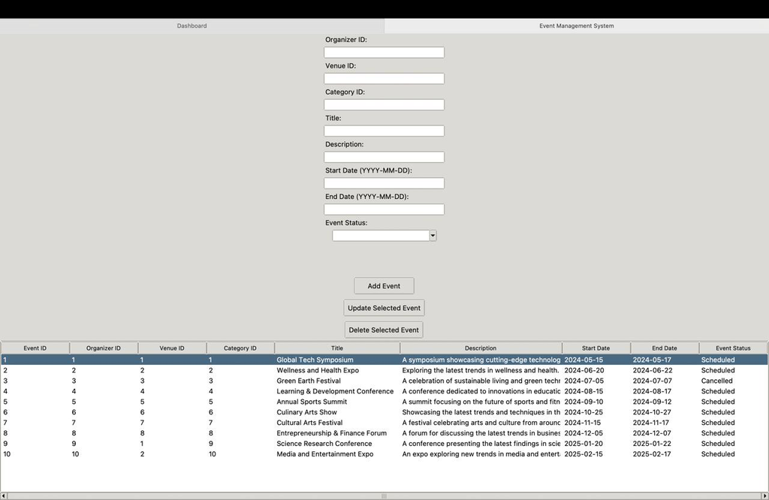
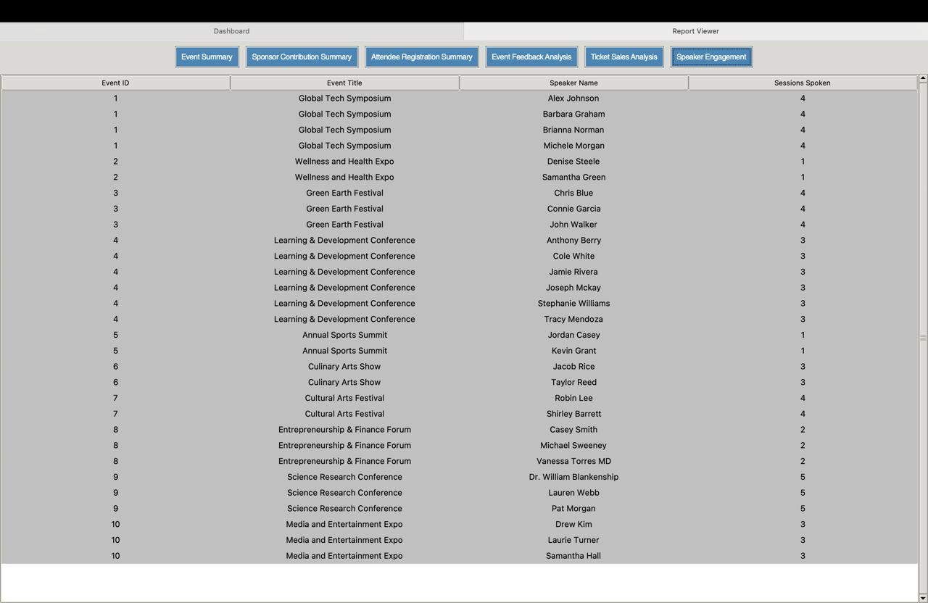
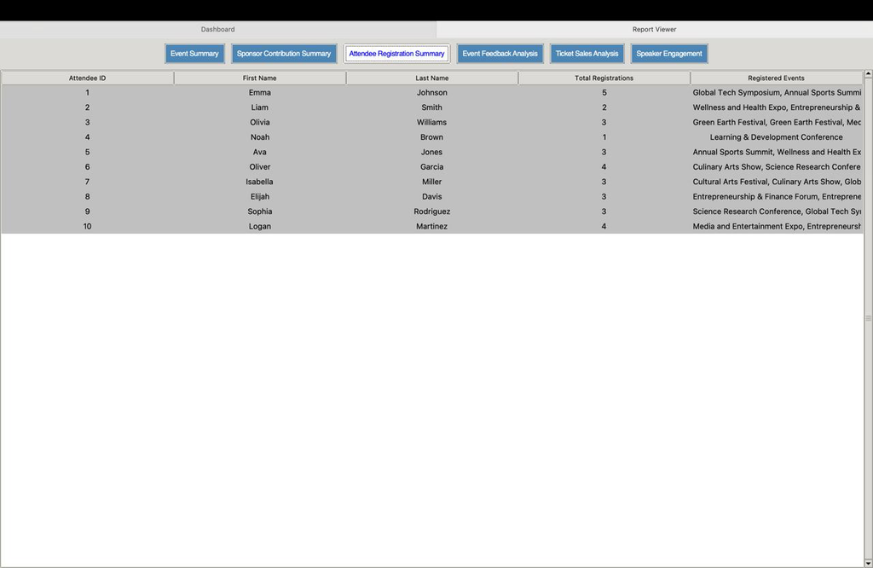
EVENT MANAGEMENT GUI
EVENT CRUD OPERATIONS
SPEAKER CONTRIBUTION SUMMARY
ATTENDEE REGISTRATION SUMMARY

